Slide 1
Parallel Patterns: Reduction & Scan

Slide 2
Parallel Patterns Overview
Reduction
Scan

Slide 3
What are parallel Patterns
并行计算需要解决的一个问题就是，如何解决线程之间的协同工作（Working together）问题。而协同工作的关键则是通信（Communication）。
CUDA 的通信发生在内存当中，例如，多个线程可能需要从同一个内存地址中读取数据；也可能出现多个线程需要同时向同一个地址写入数据；可能出现多个线程之间需要交换数据。
五种模式
Map
Gather
Scatter
Stencil
Transpose

Slide 4
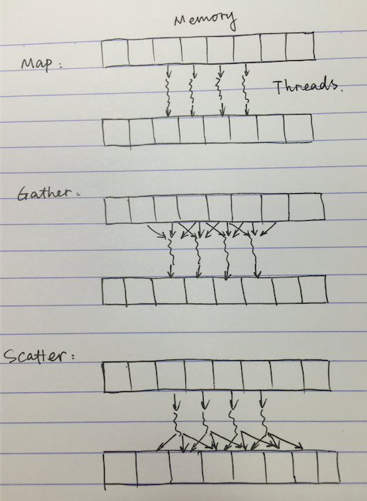
Parallel communication Patterns

Slide 5
Gather
多个输入一个输出：
Memory Values/Locations
Gather operation
Read from a number of locations
ThreadIdx.x
0 |  | 1 |  | 2 |  | 3
0 | 1 | 2 | 3 | 4 | 5 | 6 | 7
Memory Values/Locations
Gather operation
Read from a number of locations
Random access load
ThreadIdx.x

Slide 6
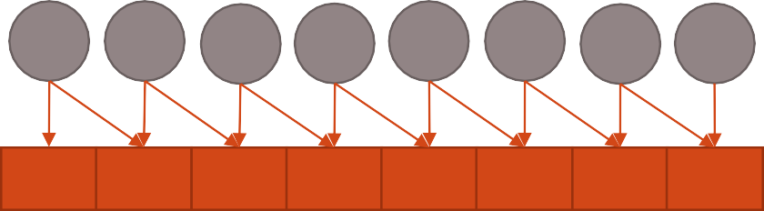
Scatter
一个输入多个输出。
同时写入多个输出的时候将出现冲突的问题
ThreadIdx.x Memory Values/Locations | 0 | 1 | 2 | 3 | 4 | 5 | 6 | 7
ThreadIdx.x | 0 | 1 | 2 | 3 | 4 | 5 | 6 | 7
Memory Values/Locations
Scatter operation
Write to a number of locations
Collision on write
Scatter operation
Write to a number of locations
Random access write?

Slide 7
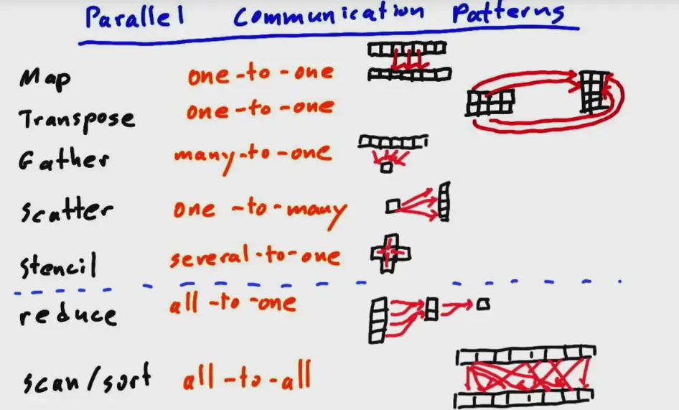

Slide 8
Other Parallel Patterns
Stencil
领域区域操作
2D shared memory examples
Reduce (this lecture)
数组相加求和
Stencil Gather
Combined with Map to form Map Reduce
Scan (this lecture)
数组累计求和
Sort (later)
Sort values or <value, key> pairs

Slide 9
Parallel Patterns Overview
Reduction
Scan

Slide 10

Reduction
给一组数据，一个满足结合律的二元操作符⊕，那么reduce可以表示为：
加法操作
E.g. (1 + 2) + 3 + 4 == 1 + (2 + 3) + 4 == 10
Example
addition (Summation)
Maximum, Minimum, product
int sum = 0;
for (int i = 0; i < N; i++)
sum += array[i];
规约的特点：可交换性，计算结果和计算顺序无关。所以max,min等问题也可以用相同的方法解决。
Notes:
可以理解为将一个数组中的所有数相加求和的过程并行化

Slide 11
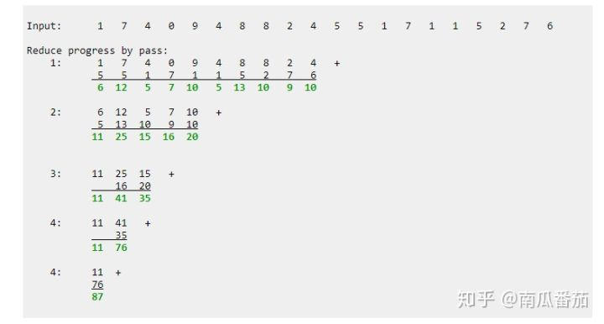
Reduction

Slide 12

Parallel Reduction in CUDA
由于每个线程块是对部分数据进行reduce，那么其输出结果如何通信，cuda没有global synchronization
3 1 7 0 4 1 6 3 3 1 7 0 4 1 6 3 3 1 7 0 4 1 6 3 3 1 7 0 4 1 6 3 3 1 7 0 4 1 6 3 3 1 7 0 4 1 6 3 3 1 7 0 4 1 6 3 3 1 7 0 4 1 6 3
4 7 5 9 4 7 5 9 4 7 5 9 4 7 5 9 4 7 5 9 4 7 5 9 4 7 5 9 4 7 5 9
11 14 11 14 11 14 11 14 11 14 11 14 11 14 11 14
25 25 25 25 25 25 25 25
Level 0:
8 blocks
3 1 7 0 4 1 6 3
4 7 5 9
11 14
Level 1:
1 block
25

Slide 13

Recursive Reduction Problems
Values (shared memory)
10 | 1 | 8 | -1 | 0 | -2 | 3 | 5 | -2 | -3 | 2 | 7 | 0 | 11 | 0 | 2
Step 1
Stride 1
Thread
IDs
Values
Thread IDs
Values
Thread IDs
Values
Thread IDs
Values
0
2
4
6
8
10
12
14
11 | 1 | 7 | -1 | -2 | -2 | 8 | 5 | -5 | -3 | 9 | 7 | 11 | 11 | 2 | 2
Step 2
Stride 2
0
4
8
12
18 | 1 | 7 | -1 | 6 | -2 | 8 | 5 | 4 | -3 | 9 | 7 | 13 | 11 | 2 | 2
Step 3
Stride 4
0
8
24 | 1 | 7 | -1 | 6 | -2 | 8 | 5 | 17 | -3 | 9 | 7 | 13 | 11 | 2 | 2
Step 4
Stride 8
0
41 | 1 | 7 | -1 | 6 | -2 | 8 | 5 | 17 | -3 | 9 | 7 | 13 | 11 | 2 | 2
Notes:
可以看到，每个block里reduce都在其shared memory里进行。如上面讨论过的，结果最终在每个block的0号线程里得到，并且存储在其shared memory sdata[0]里，而sdata[0]的值就是这个block输出的reduce的结果。

Slide 14
Recursive Reduction Problems
// Recursive Implementation of Interleaved Pair Approach
int cpuRecursiveReduce(int *data, int const size)
{
// stop condition
if (size == 1) return data[0];
// renew the stride
int const stride = size / 2;
// in-place reduction
for (int i = 0; i < stride; i++)
{
data[i] += data[i + stride];
}
// call recursively
return cpuRecursiveReduce(data, stride);
}
Notes:
可以看到，每个block里reduce都在其shared memory里进行。如上面讨论过的，结果最终在每个block的0号线程里得到，并且存储在其shared memory sdata[0]里，而sdata[0]的值就是这个block输出的reduce的结果。

Slide 15
Recursive Reduction Problems
global void reduce0(int *g_idata, int *g_odata) { extern shared int sdata[];
// each thread loads one element from global to shared mem unsigned int tid = threadIdx.x;
unsigned int i = blockIdx.x*blockDim.x + threadIdx.x; sdata[tid] = g_idata[i];
syncthreads();
// do reduction in shared mem
for(unsigned int s=1; s < blockDim.x; s *= 2) { if (tid % (2*s) == 0) {
sdata[tid] += sdata[tid + s];
}
syncthreads();
}
// write result for this block to global mem if (tid == 0) g_odata[blockIdx.x] = sdata[0];
}

Slide 16
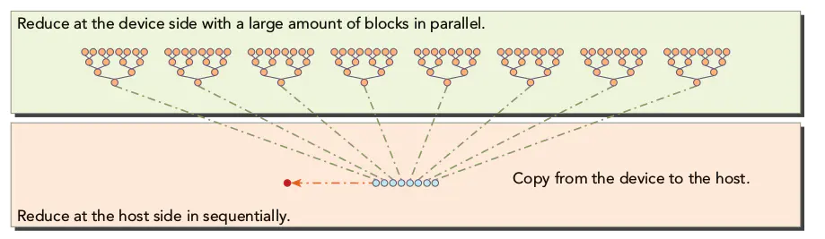
Recursive Reduction Problems
一个block处理过程分析：
block 0：data 0～data 7
一个block处理的开始数据地址：
int *idata = g_idata + blockIdx.x * blockDim.x;
for (int stride = 1; stride < blockDim.x; stride *= 2)
1.stride=1，tid=0，2，4，6四个thread计算相邻元素的和。
2.stride=2，tid=0，4的线程参与计算 3.stride=4，tid=0参与了计算，完成了3 1 7 0 4 1 6 3 这8个数据的求和计算，并将结果保存到g_odata[0]=25;
假设有64个数据，8个block，每个block处理8个数据的和。
g_idata保存了输入的原始数据，g_odata有8个数据，g_odata[i]表示的是block i的计算总和，
当在CPU端串行计算g_odata数组的和则计算出了所有数据的总和。

Slide 17
性能
Time (2²² ints)
Bandwidth
Kernel 1: interleaved addressing with divergent branching | 8.054 ms | 2.083 GB/s
Note: Block Size = 128 threads for all tests

Slide 18
Problem #1：Warp divergence
global void reduce1(int *g_idata, int *g_odata) { extern shared int sdata[];
// each thread loads one element from global to shared mem unsigned int tid = threadIdx.x;
unsigned int i = blockIdx.x*blockDim.x + threadIdx.x; sdata[tid] = g_idata[i];
syncthreads();
// do reduction in shared mem
for (unsigned int s=1; s < blockDim.x; s *= 2) { if (tid % (2*s) == 0) {
sdata[tid] += sdata[tid + s];
只有当tid满足一定条件时才会执行，
如比计算8个数据时：
第一次迭代：tid=0,2,4,6只有一半的线程需要进行计算。
第二次迭代：tid=0,4只有25%的线程参与了计算。
第三次迭代：tid=0,只有1个线程参与了计算
}
syncthreads();
}
// write result for this block to global mem if (tid == 0) g_odata[blockIdx.x] = sdata[0];
}
Notes:
逻辑上可行，但在实现上这里存在一个Warp Divergence问题。
虽然只有一部分线程参与计算，但是也需要调度所有的线程。因为线程的调度以warp为基本单位，warp是32个连续的thread，比如第二次迭代时：线程0-4，虽然只需要0和4进行计算，但是仍然要调度1，3线程。

Slide 19
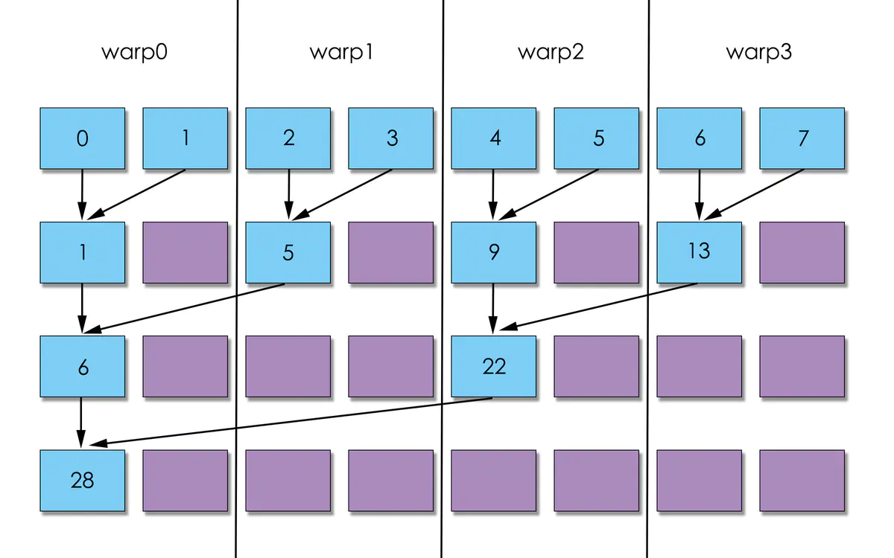
Notes:
逻辑上可行，但在实现上这里存在一个Warp Divergence问题。
虽然只有一部分线程参与计算，但是也需要调度所有的线程。因为线程的调度以warp为基本单位，warp是32个连续的thread，比如第二次迭代时：线程0-4，虽然只需要0和4进行计算，但是仍然要调度1，3线程。

Slide 20
Reduction #2: Interleaved Addressing
Just replace divergent branch in inner loop:
for (unsigned int s=1; s < blockDim.x; s *= 2) { if (tid % (2*s) == 0) {
sdata[tid] += sdata[tid + s];
}
syncthreads();
}
With strided index and non-divergent branch:
for (unsigned int s=1; s < blockDim.x; s *= 2) { int index = 2 * s * tid;
if (index < blockDim.x) {
sdata[index] += sdata[index + s];
}
syncthreads();
}
Notes:
如果一个block有512个threads，第一次迭代时8个warp reduction，剩余8个warp do nothing，第二次迭代 4个warp reduction，剩余12个warp do nothing，第三次迭代2个warp执行，剩余14个warp donothing，第四次1个warp执行...

Slide 21
Parallel Reduction: Interleaved Addressing
Values (shared memory)
10 | 1 | 8 | -1 | 0 | -2 | 3 | 5 | -2 | -3 | 2 | 7 | 0 | 11 | 0 | 2
Step 1
Stride 1
Thread
IDs
Values
Thread IDs
Values
Thread IDs
Values
Thread IDs
Values
0
1
2
3
4
5
6
7
11 | 1 | 7 | -1 | -2 | -2 | 8 | 5 | -5 | -3 | 9 | 7 | 11 | 11 | 2 | 2
Step 2
Stride 2
0
1
2
3
18 | 1 | 7 | -1 | 6 | -2 | 8 | 5 | 4 | -3 | 9 | 7 | 13 | 11 | 2 | 2
Step 3
Stride 4
0
1
24 | 1 | 7 | -1 | 6 | -2 | 8 | 5 | 17 | -3 | 9 | 7 | 13 | 11 | 2 | 2
Step 4
Stride 8
0
41 | 1 | 7 | -1 | 6 | -2 | 8 | 5 | 17 | -3 | 9 | 7 | 13 | 11 | 2 | 2

Slide 22
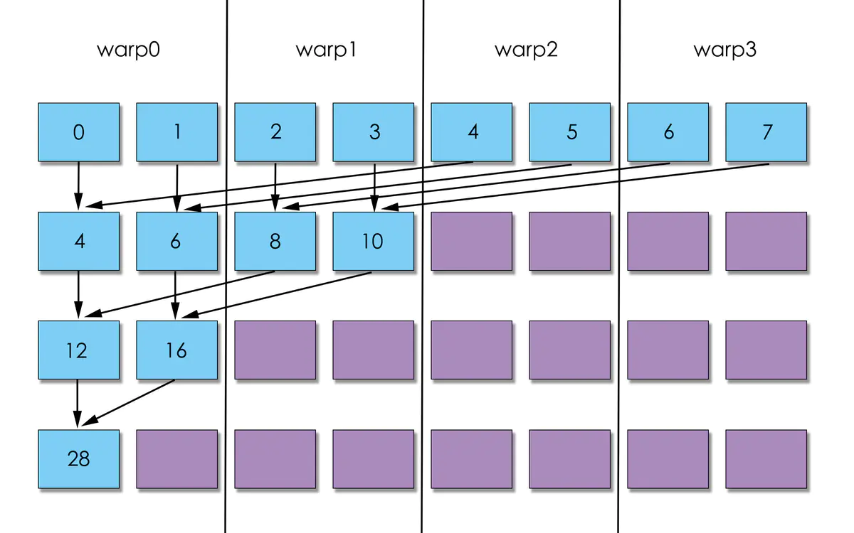
Parallel Reduction: Interleaved Addressing

Slide 23
Performance for 4M element reduction
Step Speedup
Cumulative Speedup
Time (2²² ints)
Bandwidth
Kernel 1: interleaved addressing with divergent branching | 8.054 ms | 2.083 GB/s
Kernel 2: interleaved addressing with bank conflicts | 3.456 ms | 4.854 GB/s | 2.33x | 2.33x

Slide 24
Parallel Reduction: Interleaved Addressing
Values (shared memory)
10 | 1 | 8 | -1 | 0 | -2 | 3 | 5 | -2 | -3 | 2 | 7 | 0 | 11 | 0 | 2
Step 1
Stride 1
Thread
IDs
Values
Thread IDs
Values
Thread IDs
Values
Thread IDs
Values
0
1
2
3
4
5
6
7
11 | 1 | 7 | -1 | -2 | -2 | 8 | 5 | -5 | -3 | 9 | 7 | 11 | 11 | 2 | 2
Step 2
Stride 2
0
1
2
3
18 | 1 | 7 | -1 | 6 | -2 | 8 | 5 | 4 | -3 | 9 | 7 | 13 | 11 | 2 | 2
Step 3
Stride 4
0
1
24 | 1 | 7 | -1 | 6 | -2 | 8 | 5 | 17 | -3 | 9 | 7 | 13 | 11 | 2 | 2
Step 4
Stride 8
0
41 | 1 | 7 | -1 | 6 | -2 | 8 | 5 | 17 | -3 | 9 | 7 | 13 | 11 | 2 | 2
New Problem: Shared Memory Bank Conflicts

Slide 25
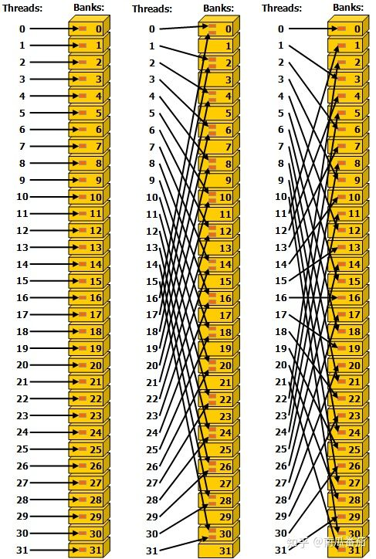
Problem #2：Shared Memory Bank Conflicts
address: bank:
0 0 <-----------------------Thread 0
1 1
2 2
3 3
4 0 <---------Thread 1/ Thread 2
5 1
6 2
7 3 <-----------------------Thread 3
8 0
...
Notes:
bank conflict 指的是当同一个warp里的多个线程对同一个bank发出访问请求，只能进行串行访问，极大影响了并行效率。

Slide 26
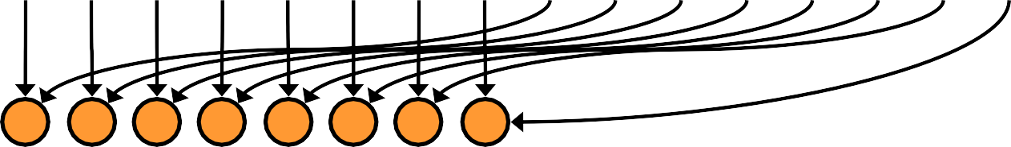

Reduction #3: Sequential Addressing
Values (shared memory)
10 | 1 | 8 | -1 | 0 | -2 | 3 | 5 | -2 | -3 | 2 | 7 | 0 | 11 | 0 | 2
Step 1
Stride 8
Thread IDs
0 | 1 | 2 | 3 | 4 | 5 | 6 | 7
8 | -2 | 10 | 6 | 0 | 9 | 3 | 7 | -2 | -3 | 2 | 7 | 0 | 11 | 0 | 2
0 | 1 | 2 | 3
8 | 7 | 13 | 13 | 0 | 9 | 3 | 7 | -2 | -3 | 2 | 7 | 0 | 11 | 0 | 2
0 | 1
21 | 20 | 13 | 13 | 0 | 9 | 3 | 7 | -2 | -3 | 2 | 7 | 0 | 11 | 0 | 2
0
Values
Step 2
Stride 4
Thread IDs
Values
Thread IDs
Values
Thread IDs
Values
Step 3
Stride 2
Step 4
Stride 1
41 | 20 | 13 | 13 | 0 | 9 | 3 | 7 | -2 | -3 | 2 | 7 | 0 | 11 | 0 | 2

Slide 27
Reduction #3: Sequential Addressing
Just replace strided indexing in inner loop:
for (unsigned int s=1; s < blockDim.x; s *= 2) { int index = 2 * s * tid;
if (index < blockDim.x) {
sdata[index] += sdata[index + s];
}
syncthreads();
}
With reversed loop and threadID-based indexing:
for (unsigned int s=blockDim.x/2; s>0; s>>=1) { if (tid < s) {
sdata[tid] += sdata[tid + s];
}
syncthreads();
}

Slide 28
Performance
Step Speedup
Cumulative Speedup
Time (2²² ints)
Bandwidth
Kernel 1: interleaved addressing with divergent branching | 8.054 ms | 2.083 GB/s
Kernel 2: interleaved addressing with bank conflicts | 3.456 ms | 4.854 GB/s | 2.33x | 2.33x
Kernel 3: sequential addressing | 1.722 ms | 9.741 GB/s | 2.01x | 4.68x

Slide 29
Problem #3：Idle Threads
for (unsigned int s=blockDim.x/2; s>0; s>>=1) { if (tid < s) {
sdata[tid] += sdata[tid + s];
}
syncthreads();
}
s初值是 blockDim.x 的一半，当（tid < s）再执行后面指令，那意味着在第一层iteration中就有一半线程是闲置的！

Slide 30
Reduction #4: First Add During Load
Halve the number of blocks, and replace single load:
// each thread loads one element from global to shared mem unsigned int tid = threadIdx.x;
unsigned int i = blockIdx.x*blockDim.x + threadIdx.x; sdata[tid] = g_idata[i];
syncthreads();
With two loads and first add of the reduction:
// perform first level of reduction,
// reading from global memory, writing to shared memory unsigned int tid = threadIdx.x;
unsigned int i = blockIdx.x*(blockDim.x*2) + threadIdx.x;
sdata[tid] = g_idata[i] + g_idata[i+blockDim.x];
syncthreads();
Notes:
这里要注意的是分配的 block 的数量减半，kernel里体现在blockIdx.x的最大值发生了变化，而blockDim是不变的。即每个block中的线程不变，但总的线程数减少了一半。

Slide 31
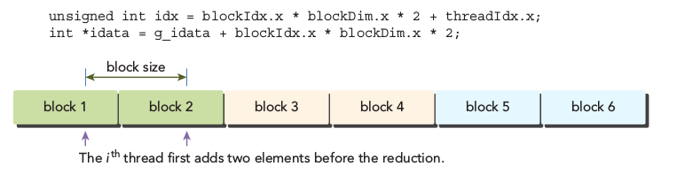
int size = 1 << 24; // total number of elements to reduce
int blocksize = 512; // initial block size
dim3 block (blocksize, 1);
dim3 grid ((size + block.x - 1) / block.x, 1);
//由于每个block处理两个data block，所以需要调整grid的配置.
reduceUnrolling2<<<grid.x / 2, block>>>(d_idata, d_odata, size);

Slide 32
Performance
Step Speedup
Cumulative Speedup
Time (2²² ints)
Bandwidth
Kernel 1: interleaved addressing with divergent branching | 8.054 ms | 2.083 GB/s
Kernel 2: interleaved addressing with bank conflicts | 3.456 ms | 4.854 GB/s | 2.33x | 2.33x
Kernel 3: sequential addressing | 1.722 ms | 9.741 GB/s | 2.01x | 4.68x
Kernel 4: first add during global load | 0.965 ms | 17.377 GB/s | 1.78x | 8.34x

Slide 33
Problem #4：Instruction Overhead
为了继续提升性能，再分析下瓶颈所在。reduction实际上是二元运算，计算强度是比较低的，所以相对的，指令调度的开销可能是瓶颈所在，特别是还有个 for 循环。
那就把 for 给展开吧！

Slide 34
Reduction #5: Unroll the Last Warp
device void warpReduce(volatile int* sdata, int tid) { sdata[tid] += sdata[tid + 32];
sdata[tid] += sdata[tid + 16]; sdata[tid] += sdata[tid + 8]; sdata[tid] += sdata[tid + 4]; sdata[tid] += sdata[tid + 2]; sdata[tid] += sdata[tid + 1];
}
IMPORTANT:
For this to be correct, we must use the “volatile” keyword!
// later…
for (unsigned int s=blockDim.x/2; s>32; s>>=1) { if (tid < s)
sdata[tid] += sdata[tid + s];
syncthreads();
}
if (tid < 32) warpReduce(sdata, tid);
Notes:
之前有提到warp中的32个线程是SIMT策略，意味着，当tid < 32 的时候，并不需要等待其他线程咯，也就是不需要__syncthreads() 指令，而warp的32个线程的又是顺序分配的，步进方式也知道，即右移1位，那么可以把最后的warp展开，而且也不需要每次都 if(tid < s) ：
32个thread处理64个数据相加： 第一次迭代：[0]+[0+32]、[1]+[[1+32]、[2]+[[2+32]...[31]+[31+32]由于这32个线程在一个warp中，所以这些计算默认是同步的，计算结果保存到[0-31]。 第二次迭代：[0]+[0+16]、[1]+[[1+16]、[2]+[[2+16]...[15]+[15+16]...（[15]+[15+16]），由于这32个线程在一个warp中，所以这些计算默认是同步的，计算结果仍然保存到[0-31],但是有效的计算结果只有[0-15]. 第三次迭代：[0]+[0+8]、[1]+[[1+8]、[2]+[[2+8]...[7]+[7+8]...([31]+[31+8]),有效的计算结果保存到[0-7]. 第四次迭代：[0]+[0+4]、[1]+[[1+4]、[2]+[[2+4]、[3]+[3+4]...([31]+[31+4]),有效的计算结果保存到[0-3]. 第五次迭代：[0]+[0+2]、[1]+[[1+2]...([31]+[31+2]),有效的计算结果保存到[0-1]. 第六次迭代：[0]+[0+1]...[31]+[31+1],有效的计算结果保存到[0].

Slide 35
Performance
Step Speedup
Cumulative Speedup
Time (2²² ints)
Bandwidth
Kernel 1: interleaved addressing with divergent branching | 8.054 ms | 2.083 GB/s
Kernel 2: interleaved addressing with bank conflicts | 3.456 ms | 4.854 GB/s | 2.33x | 2.33x
Kernel 3: sequential addressing | 1.722 ms | 9.741 GB/s | 2.01x | 4.68x
Kernel 4: first add during global load | 0.965 ms | 17.377 GB/s | 1.78x | 8.34x
Kernel 5: unroll last warp | 0.536 ms | 31.289 GB/s | 1.8x | 15.01x

Slide 36
Reduction #6: Completely Unrolled
if (blockSize >=1024){
if (tid < 512) {sdata[tid] += sdata[tid + 512];} __syncthreads();
}
if (blockSize >= 512) {
if (tid < 256) { sdata[tid] += sdata[tid + 256]; } __syncthreads();
}
if (blockSize >= 256) {
if (tid < 128) { sdata[tid] += sdata[tid + 128]; } __syncthreads();
}
if (blockSize >= 128) {
if (tid < 64) { sdata[tid] += sdata[tid + 64]; } __syncthreads();
}
if (tid < 32) {
if (blockSize >= 64) sdata[tid] += sdata[tid + 32];
if (blockSize >= 32) sdata[tid] += sdata[tid + 16];
if (blockSize >= 16) sdata[tid] += sdata[tid + 8];
if (blockSize >= 8) sdata[tid] += sdata[tid + 4];
if (blockSize >= 4) sdata[tid] += sdata[tid + 2];
if (blockSize >= 2) sdata[tid] += sdata[tid + 1];
}
Notes:
那好就好在，对于现在的GPU，其单个 block 所能容纳的最大线程数是已知的：1024个。随着软硬件更新，这个限制也发生着变化，就比如Mark Harris大神在写《Optimizing Parallel Reduction in CUDA》时，这个数字还是512。不过这不是讨论重点，重点是这个数字已知。

Slide 37
Performance
Step Speedup
Cumulative Speedup
Time (2²² ints)
Bandwidth
Kernel 1: interleaved addressing with divergent branching | 8.054 ms | 2.083 GB/s
Kernel 2: interleaved addressing with bank conflicts | 3.456 ms | 4.854 GB/s | 2.33x | 2.33x
Kernel 3: sequential addressing | 1.722 ms | 9.741 GB/s | 2.01x | 4.68x
Kernel 4: first add during global load | 0.965 ms | 17.377 GB/s | 1.78x | 8.34x
Kernel 5: unroll last warp | 0.536 ms | 31.289 GB/s | 1.8x | 15.01x
Kernel 6: completely unrolled | 0.381 ms | 43.996 GB/s | 1.41x | 21.16x

Slide 38
Recursive Reduction Problems
global void sum_reduction(float *input, float *results){
extern shared int sdata[];
unsigned int i = blockIdx.x*blockDim.x + threadIdx.x;
sdata[threadIdx.x] = input[i];
syncthreads();
if (i % 2 == 0){
results[i / 2] = sdata[threadIdx.x] + sdata[threadIdx.x+1]
}
}
Notes:
High Launch Overhead
Lots of reads/writes from global memory
Poor use of shared memory or caching
Expensive % and / operators
Divergent warps
可以看到，每个block里reduce都在其shared memory里进行。如上面讨论过的，结果最终在每个block的0号线程里得到，并且存储在其shared memory sdata[0]里，而sdata[0]的值就是这个block输出的reduce的结果。逻辑上可行，但在实现上这里存在一个Warp Divergence问题。

Slide 39
Block Level Reduction
global void sum_reduction(float *input, float *block_results){
extern shared int sdata[];
unsigned int i = blockIdx.x*blockDim.x + threadIdx.x;
sdata[threadIdx.x] = input[i];
syncthreads();
for (unsigned int stride = 1; stride < blockDim.x; stride*=2){
unsigned int strided_i = threadIdx.x * 2 * stride;
if (strided_i < blockDim.x){
sdata[strided_i] += sdata[strided_i + stride]
}
syncthreads();
}
if (threadIdx.x == 0) block_results[blockIdx.x] = sdata[0];
}
Notes:
Lower launch overhead (reduction within block)
Much better use of shared memory

Slide 40
Block Level Recursive Reduction
Shared Memory Values | 9 | 5 | 2 | 1 | 2 | 3 | 8 | 1
threadIdx.x | 0 |  | 1 |  | 2 |  | 3
Shared Memory Values | 14 | 5 | 3 | 1 | 5 | 3 | 9 | 1
threadIdx.x | 0 |  |  |  | 1
Shared Memory Values | 17 | 5 | 3 | 1 | 14 | 3 | 9 | 1
Loop 1 stride | = | 1
Loop 2 stride | = | 2
Loop 3 stride | = | 4
threadIdx.x
0
Shared Memory Values
31 | 5 | 3 | 1 | 14 | 3 | 9 | 1
for (unsigned int stride = 1; stride < blockDim.x; stride*=2){
unsigned int strided_i = threadIdx.x * 2 * stride;
if (strided_i < blockDim.x){
sdata[strided_i] += sdata[strided_i + stride]
}
syncthreads();
}

Slide 41
Block Level Reduction
for (unsigned int stride = 1; stride < blockDim.x; stride*=2){ unsigned int strided_i = threadIdx.x * 2 * stride;
if (strided_i < blockDim.x){
sdata[strided_i] += sdata[strided_i + stride]
}
syncthreads();
}
address: bank:
0 0 <-----------------------Thread 0
1 1
2 2
3 3
4 0 <---------Thread 1/ Thread 2
5 1
6 2
7 3 <-----------------------Thread 3
8 0
...
Notes:
Is this shared memory access pattern bank conflict free?

Slide 42

Block Level Reduction
sm_stride | 1
loop stride | 1
0 |  |  | 1 | 1
1 |  |  | 3 | 3
2 |  |  | 5 | 5
3 |  |  | 7 | 7
4 |  |  | 9 | 9
5 |  |  | 11 | 11
6 |  |  | 13 | 13
7 |  |  | 15 | 15
8 |  |  | 17 | 17
9 |  |  | 19 | 19
10 |  |  | 21 | 21
11 |  |  | 23 | 23
12 |  |  | 25 | 25
13 |  |  | 27 | 27
14 |  |  | 29 | 29
15 |  |  | 31 | 31
16 |  |  | 33 | 1
17 |  |  | 35 | 3
18 |  |  | 37 | 5
19 |  |  | 39 | 7
20 |  |  | 41 | 9
21 |  |  | 43 | 11
22 |  |  | 45 | 13
23 |  |  | 47 | 15
24 |  |  | 49 | 17
25 |  |  | 51 | 19
26 |  |  | 53 | 21
27 |  |  | 55 | 23
28 |  |  | 57 | 25
29 |  |  | 59 | 27
30 |  |  | 61 | 29
31 |  |  | 63 | 31
 |  |  | Banks Used | 16
 |  |  | Max Conflicts | 2
threadIdx.x
index
bank
for (unsigned int stride = 1; stride < blockDim.x; stride*=2){ unsigned int strided_i = threadIdx.x * 2 * stride;
if (strided_i < blockDim.x){
sdata[strided_i] += sdata[strided_i + stride]
}
syncthreads();
}

Slide 43
Block Level Reduction (Sequential Addressing)
Shared Memory Values
9 | 5 | 2 | 1 | 2 | 3 | 8 | 1
Loop 1
stride = 4
threadIdx.x
0 1
2 3
Shared Memory Values
11 | 8 | 10 | 2 | 2 | 3 | 8 | 1
Loop 2
stride = 2
threadIdx.x
0 1
Shared Memory Values
21 | 10 | 10 | 2 | 2 | 3 | 8 | 1
Loop 3
stride = 1
threadIdx.x
0
Shared Memory Values
31 | 10 | 10 | 2 | 2 | 3 | 8 | 1
stride /=2
for (unsigned int stride = blockDim.x/2; stride > 0; | stride>>=1 | ){
if (threadIdx.x < stride){ sdata[threadIdx.x] += sdata[threadIdx.x + stride] } syncthreads(); }
Notes:
s初值是 blockDim.x 的一半，当（tid < s）再执行后面指令，那意味着在第一层iteration中就有一半线程是闲置的，这也太浪费了吧！怎么办？看到前面的给shared memory传值的语句

Slide 44
sm_stride | 1
loop stride | 1
threadIdx.x |  |  | index | bank
0 |  |  | 1 | 1
1 |  |  | 2 | 2
2 |  |  | 3 | 3
3 |  |  | 4 | 4
4 |  |  | 5 | 5
5 |  |  | 6 | 6
6 |  |  | 7 | 7
7 |  |  | 8 | 8
8 |  |  | 9 | 9
9 |  |  | 10 | 10
10 |  |  | 11 | 11
11 |  |  | 12 | 12
12 |  |  | 13 | 13
13 |  |  | 14 | 14
14 |  |  | 15 | 15
15 |  |  | 16 | 16
16 |  |  | 17 | 17
17 |  |  | 18 | 18
18 |  |  | 19 | 19
19 |  |  | 20 | 20
20 |  |  | 21 | 21
21 |  |  | 22 | 22
22 |  |  | 23 | 23
23 |  |  | 24 | 24
24 |  |  | 25 | 25
25 |  |  | 26 | 26
26 |  |  | 27 | 27
27 |  |  | 28 | 28
28 |  |  | 29 | 29
29 |  |  | 30 | 30
30 |  |  | 31 | 31
31 |  |  | 32 | 0
 |  |  | Banks Used | 32
 |  |  | Max Conflicts | 1
Now conflict free regardless of the reduction loop stride
The stride between shared memory variable accesses for threads is always sequential
Careful: Two types of stride discussed
Loop stride (of algorithm)
SM variable stride (in 4 bytes)

Slide 45
Global Reduction Approach
Thread block width
Notes:
Use the recursive method
Our block level reduction can be applied to the result
At some stage it may be more effective to simply sum the final block on the
CPU
Or use atomics on block results

Slide 46
Global Reduction Atomics
global void sum_reduction(float *input, float *result){
extern shared int sdata[];
unsigned int i = blockIdx.x*blockDim.x + threadIdx.x;
sdata[threadIdx.x] = input[i];
syncthreads();
for (unsigned int stride = blockDim.x/2; stride > 0; stride>>=2){
if (threadIdx.x < stride){
sdata[threadIdx.x] += sdata[threadIdx.x + stride]
}
syncthreads();
}
if (threadIdx.x == 0)
atomicAdd(result, sdata[0]);
}

Slide 47
Further Optimisation?
Can we improve our technique further?
global void sum_reduction(float *input, float *result){ extern shared int sdata[];
unsigned int i = blockIdx.x*blockDim.x + threadIdx.x;
sdata[threadIdx.x] = input[i];
syncthreads();
for (unsigned int stride = blockDim.x/2; stride > 0; stride>>=2){
if (threadIdx.x < stride){
sdata[threadIdx.x] += sdata[threadIdx.x + stride]
}
syncthreads();
}
if (threadIdx.x == 0) atomicAdd(result, sdata[0]);
}

Slide 48
Further Optimisation?
Can we improve our technique further? Yes
We could optimise for the warp level
Warp Level: Shuffles for reduction (see last lecture)
Thread Block Level: Shared Memory reduction (or Maxwell SM atomics)
Grid Block Level: Recursive Kernel Launches or Global Atomics
Other optimisations
Loop unrolling
Increasing Thread Level Parallelism
Different architectures may favour different implementations/optimisations

Slide 49
Parallel Patterns Overview
Reduction
Scan

Slide 50
Scan
定义：
Given the inputs A = [a0, a1, …, an-1] and binary associate operator ⊕
Scan(A) = [0, a0, (a0⊕a1), …, (a0⊕a1⊕…⊕an-1)]
例子：
[3 1 7 0 4 1 6 3],
[3 4 11 11 14 16 22 25].

Slide 51
What is scan?
Consider the following …
2 | 0 | 5 | 6 | 3 | 0 | 1 | 0
2 0 1 2 1 3 0 0
2 | 5 | 6 | 3 | 1
Remove empty elements from array (compact)
A
C | D | F | G
 | E |  | H
 |  |  | I
B
1 | 2 | 5 | 1 | 3 | 4 | 3 | 8
Output variable numbers of values per thread
1 | 5 | 1 | 3 | 3
2 | 4 | 8
Split elements from array based on condition (split)

Slide 52
What is scan?
Consider the following …
2 | 0 | 5 | 6 | 3 | 0 | 1 | 0
2 0 1 2 1 3 0 0
2 | 5 | 6 | 3 | 1
Remove empty elements from array (compact)
A
C | D | F | G
 | E |  | H
 |  |  | I
B
1 | 2 | 5 | 1 | 3 | 4 | 3 | 8
Output variable numbers of values per thread
1 | 5 | 1 | 3 | 3
2 | 4 | 8
Each has the same problem
Not even considered for sequential
programs!
Where to write output in parallel?
Split elements from array based on condition (split)

Slide 53
Parallel Prefix Sum (scan)
Where to write output in parallel?
Each threads needs to know the output location(s) it can write to avoid conflicts.
Thread/Read index
Output/Write index – running sum of binary output state Sparse data
Compacted data
0 | 1 | 2 | 3 | 4 | 5 | 6 | 7
0 | 0 | 1 | 2 | 3 | 3 | 4 | 4
2 | 0 | 5 | 6 | 3 | 0 | 1 | 0
2 | 5 | 6 | 3 | 1

Slide 54
Serial Parallel Prefix Sum Example
E.g. Given the input and the addition operator
A= |  | [2, | 6, | 2 ,4, 7, 2 | ,1, 5]
Scan(A) | = | [0, | 2, | 2+6, 2+6+2, | 2+6+2+4, …]
Scan(A) | = | [0, | 2, | 8, 10, 14, | 21, 23, 24]
int A[8] = { 2, 6, 2, 4, 7, 2, 1, 5 };
int scan_A[8];
int running_sum = 0;
for (int i = 0; i < 8; ++i)
{
scan_A[i] = running_sum;
running_sum += A[i];
}
Notes:
More generally a serial implementation of an additive scan using a
running sum looks like…

Slide 55
Serial Scan for Compaction
int | Input[8] = { 2, 0, | 5, | 6, | 3, | 0, | 1, | 0 | };
int | A[8] = { 2, 0, | 5, | 6, | 3, | 0, | 1, | 0 | };
int | scan_A[8];
int | output[5]
int | running_sum = 0;
for (int i = 0; i < 8; ++i){ A[i] = Input>0;
}
for (int i = 0; i < 8; ++i){ scan_A[i] = running_sum; running_sum += A[i];
}
for (int i = 0; i < 8; ++i){ int input = Input[i];
if (input > 0){
int idx = scan[i]; output[idx] = input;
}
}
// generate scan input
// A = {1, 0, 1, 1, 1, 0, 1, 0}
// scan
// result = {0, 1, 1, 2, 3, 4, 4, 5}
// | scattered write
// | output = {2, 5, | 6, 3, | 1}

Slide 56
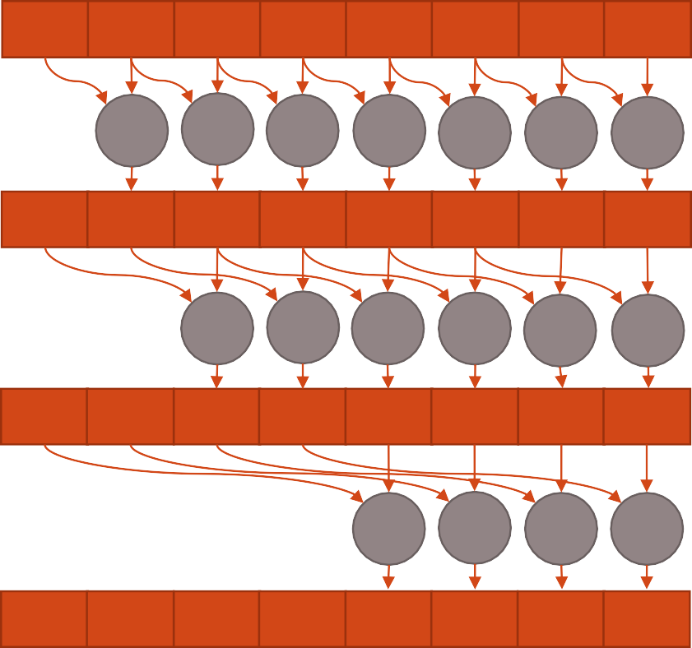
Parallel Local (Shared Memory) Scan
After Log(N) loops each sum has local plus preceding 2^{n}-1 values
Shared Memory Values
2 6 2 4 7 2 1 5
Loop 1
stride = 1
threadIdx.x
0 1 2 3 4 5 6
2 8 8 6 11 9 3 6
Shared Memory Values
Loop 2 stride | = | 2
Loop 3 stride | = | 4
Log₂(N) steps
threadIdx.x |  |  | 0 | 1 | 2 | 3 | 4 | 5
Shared Memory Values | 2 | 8 | 10 | 14 | 19 | 15 | 14 | 15
threadIdx.x |  |  |  |  | 0 | 1 | 2 | 3
Shared Memory Values | 2 | 8 | 10 | 14 | 21 | 23 | 24 | 29
Inclusive Scan

Slide 57
Parallel Local Scan
Shared Memory Values
2 6 2 4 7 2 1 5
Loop 1
stride = 1
threadIdx.x
0
1
2 3
4 5 6
Shared Memory Values
2 8 8 6 11 9 3 6
Loop 2 stride | = | 2
Loop 3 stride | = | 4
Log₂(N) steps
threadIdx.x |  |  | 0 | 1 | 2 | 3 | 4 | 5
Shared Memory Values | 2 | 8 | 10 | 14 | 19 | 15 | 14 | 15
threadIdx.x
0
1
2 3
Shared Memory Values
2 8 10 14 21 23 24 29
Inclusive scan
29 Exclusive scan + reduction
0 | 2 | 8 | 10 | 14 | 21 | 23 | 24

Slide 58
Implementing Local Scan with Shared Memory
global void scan(float *input) { extern shared float s_data[];
s_data[threadIdx.x] = input[threadIdx.x + blockIdx.x*blockDim.x];
for (int stride = 1; stride<blockDim.x; stride<<=1) {
syncthreads();
float s_value = (threadIdx.x >= stride) ? s_data[threadIdx.x - stride] : 0;
syncthreads();
s_data[threadIdx.x] += s_value;
}
//something with global results?
}
No bank conflicts (stride of 1 between threads)
Synchronisation required between read and write

Slide 59
Implementing Local Scan (at warp level)
global void scan(float *input) {
shared float s_data[32];
float val1, val2;
val1 = input[threadIdx.x + blockIdx.x*blockDim.x]; for (int s = 1; s < 32; s <<= 1) {
val2 = shfl_up(val1, s);
if (threadIdx.x % 32 >= s)
val1 += val2;
}
//store warp level results}
Exactly the same as the block level technique but at warp level
Warp prefix sum is in threadIdx.x%32==31
Either use shared memory to reduce between warps
Or consider the following global scan approaches.

Slide 60


Implementing scan at Grid Level
Thread Block 1
Thread Block 2
Shared Memory Values
threadIdx.x
Shared Memory Values
threadIdx.x Shared Memory Values threadIdx.x
Local Scan Result Global Scan Result
2 | 6 | 2 | 4 | 7 | 2 | 1 | 5 | 4 | 2 | 2 | 4 | 1 | 0 | 1 | 2
 | 0 | 1 | 2 | 3 | 4 | 5 | 6 |  | 0 | 1 | 2 | 3 | 4 | 5 | 6
2 | 8 | 8 | 6 | 11 | 9 | 3 | 6 | 4 | 6 | 4 | 6 | 5 | 1 | 1 | 3
 |  | 0 | 1 | 2 | 3 | 4 | 5 |  |  | 0 | 1 | 2 | 3 | 4 | 5
2 | 8 | 10 | 14 | 19 | 15 | 14 | 15 | 4 | 6 | 8 | 12 | 9 | 7 | 6 | 4
 |  |  |  | 0 | 1 | 2 | 3 |  |  |  |  | 0 | 1 | 2 | 3
2 | 8 | 10 | 14 | 21 | 23 | 24 | 29 | 4 | 6 | 8 | 12 | 13 | 13 | 14 | 16
2 | 8 | 10 | 14 | 21 | 23 | 24 | 29
33 | 35 | 37 | 41 | 42 | 42 | 43 | 45

Slide 61
Implementing scan at Grid Level
Same problem as reduction when scaling to grid level
Each block is required to add the reduction value from proceeding blocks
Global scan therefore requires either;
Recursive scan kernel on results of local scan
Additional kernel to add sums of proceeding blocks
Atomic Increments (next slides)
Increment a counter for block level results
Additional kernel to add sums of proceeding blocks to each value

Slide 62
Global Level Scan (Atomics Part 1)
device block_sums[BLOCK_DIM];
global void scan(float *input, float *local_result) {
extern shared float s_data[];
s_data[threadIdx.x] = input[threadIdx.x + blockIdx.x*blockDim.x];
for (int stride = 1; stride<blockDim.x; stride<<=1) {
syncthreads();
float s_value = (threadIdx.x >= stride) ? s_data[threadIdx.x - stride] : 0;
syncthreads();
s_data[threadIdx.x] += s_value;
}
//store local scan result to each thread
local_result[threadIdx.x + blockIdx.x*blockDim.x] = s_data[threadIdx.x];
//atomic store to all proceeding block totals
if (threadIdx.x == 0){
for (int i=0; i<blockIdx.x; i++)
atomicAdd(&block_sums[i], s_data[blockDim.x-1]);
}
}

Slide 63
Global Level Scan (Atomics Part 2)
After completion of the first kernel, block sums are all synchronised
Use first thread in block to load block total into shared memory
Increment local result
device block_sums[BLOCK_DIM];
global void scan_update(float *local_result, float *global_result) { extern shared float block_total;
int idx = threadIdx.x + blockIdx.x*blockDim.x;
if (threadIdx.x == 0)
block_total = block_sums[blockIdx.x];
syncthreads();
global_result[idx] = local_result[idx]+block_total;
}

Slide 64
Acknowledgements and Further Reading
https://devblogs.nvidia.com/parallelforall/faster-parallel-reductions- kepler/
All about application of warp shuffles to reduction
https://stanford-cs193g- sp2010.googlecode.com/svn/trunk/lectures/lecture_6/parallel_patte rns_1.ppt
Scan material based loosely on this lecture
http://docs.nvidia.com/cuda/samples/6_Advanced/reduction/doc/re duction.pdf
Reduction material is based on this fantastic lecture by Mark Harris (NVIDIA)

